Slide 1
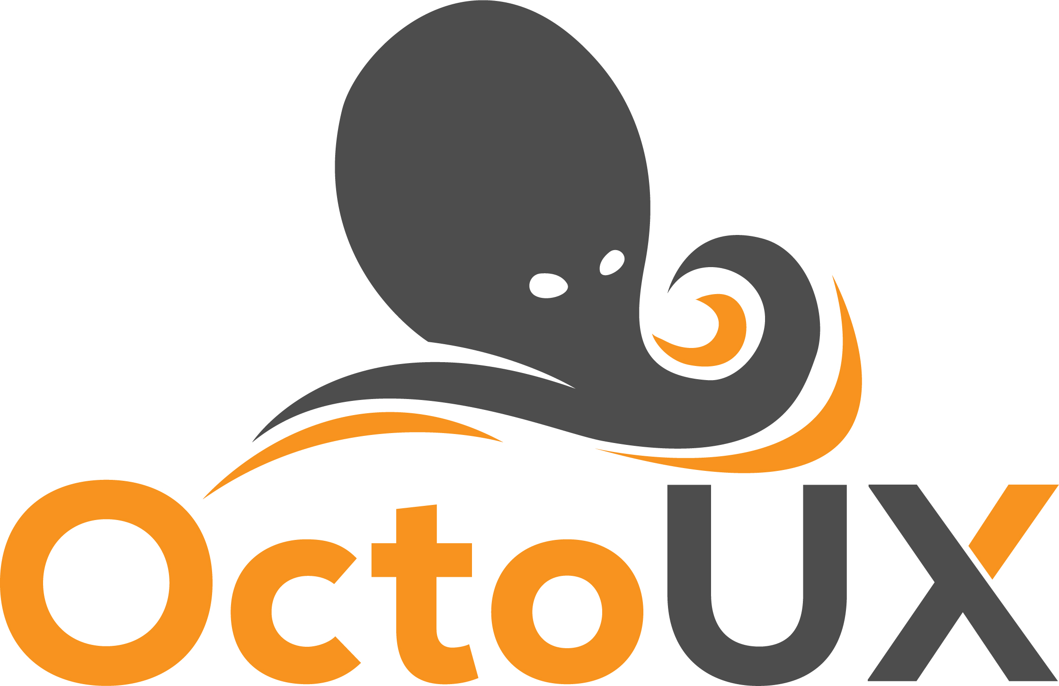
Economic Developers Guide to CRM
“Customer relationship management” can sound intimidating to small- and mid-sized businesses. Why do you need a dedicated process or system to keep track of our existing industries and prospects – it’s not like we are running Amazon.com? A few spreadsheets and rules of thumb will do just fine.
But what happens when business starts to boom? More importantly, what is the economic value of these companies and contacts? Yeah, it’s HUGE.
At some point, the organization will need to implement a customer contact management system that’s more organized and streamlined than a mass of spreadsheets. And such a migration could be painful if the decision has been put off a few too many months, or even years.
Maybe you’re running salesforce or ACT. Pro’s and con’s to each system.
Salesforce / Microsoft CRM – expensive and difficult to navigate.
ACT! ? Good for contacts, challenging to manage companies and opportunities in way that understands economic development.
At its core, a CRM is not just useful to large enterprise companies -- it’s essential for businesses of all sizes.
Let’s face it – modern economic development teams have a solid CRM that not only manages projects but also your marketing efforts as well.

Slide 2
So, let’s start at the beginning …
^{What is a CRM?}
CRM stand for customer relationship management, and it refers to software that helps companies track interactions with their future and current customers.
The goal of implementing a CRM is to create a system that your sales and marketing teams can use to more efficiently and effectively interact with prospects or customers.
Marketing will often use a CRM to ensure that they’re passing the right leads to their sales team -- a key aspect of developing a strong relationship with the sales team.
Project Managers and anyone working to Attract Talent or Investors utilize the CRM in a different way. They use it to source prospective customers, communicate with them, and track their interactions over time. Having the entire prospect history in one place increases their efficiency and improves their productivity.
For instance, anyone using a CRM won’t have to hunt through their email to remember where a conversation left off.

Slide 3
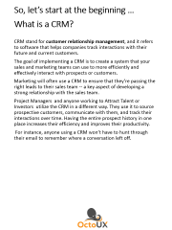
^{Which companies use a CRM?}
The short answer is that any company who seeks to maintain a relationship with their customers can benefit from using a CRM system. To get a little bit more specific, there are two groups of companies that often see the most benefit:
Economic Developers need to track leads and customers across long sales cycles and you’ll use the same system for your Existing Industry Accounts as they integrate into the community.
above two profiles, but still find value in using a CRM system. Another way to understand whether or not a CRM system can help your business is to think about the challenges that CRM systems aim to solve:
Do you have a need for maintaining a central list of information on your leads and existing industry accounts? Does this information live in many different places today?
Are your contacts and companies regularly interfacing with multiple people on your team? How does everyone keep track of where the conversation with any one customer left off?
If you answered yes to any one or more of the above questions, chances are your business could benefit from a CRM system.

Slide 4
^{4 Benefits of a CRM}
There are many things a CRM can do that should get marketers, salespeople, or business owners pretty excited! Here’s how a CRM can make you a more effective marketing and sales machine...
1. Better Lead Intelligence for Both Marketing and Sales
Wouldn’t it be helpful if you knew when a potential customer was looking at your website? Implementing a CRM will allow your sales team to know how many times potential customers have visited your site or if they have ever talked to a member of your sales team.
When you work within a CRM that integrates with their company’s marketing software, they’re able to access this type of detailed, real-time lead intelligence all from one place.
And this isn’t just beneficial to sales; it’s beneficial to marketing as well. A CRM will allow your marketing team to see which leads turn into customers. More specifically, you can see what brought them to your website and what pages they looked at before becoming a customer.
When a marketer works in a marketing platform that is integrated with a CRM, they are able to figure out which of their efforts are working best.
2. Better Sales and Marketing (Smarketing) Alignment
Real-time reporting holds both teams accountable to their goals and helps one another work together toward shared outcomes. (It’s also worth noting that CRMs are used for customers, too, not just leads; so customer service communications and metrics can be easily documented for account managers to reference as well.)

Slide 5
^{4 Benefits of a CRM}
3. Help Prioritize Deals in the Pipeline
CRM not only gives complete visibility into the sales pipeline, but it also helps sales people prioritize who to call first so they don’t miss important opportunities. When project managers and marketing set up a CRM, they can identify important criteria and even implement a lead scoring system. Organizational systems like these reduce time spent sifting through leads, and enables the team to prioritize the best opportunities.
4. Closed-Loop Reporting Lets Marketers Improve Campaigns
When you integrate marketing software with your CRM, marketing can easily analyze the effectiveness of its campaigns using closed-loop reporting. When a deal is won, the company status changes from Prospective Account to Existing Industry.
This allows marketing to do two important things:
First, marketing can automatically remove this lead for their nurturing sequences, and instead send it customer-focused information.
Secondly, marketing is now able to attribute this new customer to a specific campaign and channel. Mapping marketing activities to sales events is critical for marketing to improve future campaigns.

Slide 6
^{8 Must-Have CRM Features}
Before all else, a CRM system should be useful to its end users.
Octo – represents 8 arms or the roles our software is designed to serve.
UX – this stands for User Experience.
CRM systems have a range of functionalities, but these nine features are must-haves for any business that is aiming to organize their systems and improve their efficiency.
AGENCY LOGO

Slide 7
^{8 Must-Have CRM Features}
^{1. Contact Management}
You won’t find a CRM that doesn’t have a contact management capability. If you do, chances are you aren’t looking at a CRM. All CRM systems allow you to create contact records and store prospect and customer information in a database. However, the best systems that truly improve efficiency will reduce and streamline contact data entry as much as possible.
Judge this feature with ease of use in mind.
^{2. Deal Stages}
Most CRM systems can be customized to operate on a specific sales process. Whether your company has three deal stages or 15, you should be able to program these levels into the software and attach associated values. Our stages are designed for Economic Developers.
It should also be easy to move a deal along the sales process, from one stage to the next. In HubSpot CRM, advancing a deal is as simple as dragging and dropping:
Make sure the system you are using can be customized to your needs with ease.
AGENCY LOGO

Slide 8
^{8 Must-Have CRM Features}
^{3. Daily Dashboard}
Do need visibility into a number of metrics on a daily basis? Metrics such as their progress to date against quota, how many deals they have in their pipelines at which stages, and what outstanding tasks they need to complete. Similarly, leaders need to be able to view these categories for the aggregated sales team.
Evaluate this function based on visual appeal and simplicity.
^{4. Task Management}
A person who has to toggle back and forth between several different systems to view and complete their daily tasks is not a happy person (though this is common). CRM systems that include task management capabilities streamline your team member’s day-to-day workflow and help them keep on top of their follow up.
^{5. Content Repository}
According to Docurated’s State of Sales Productivity 2015 study, office workers spend 31% of their time hunting for or creating content. To cut back on wasted time searching for content, look for a CRM system with an embedded content repository. Look for a system that allows salespeople to save their go-to pieces of collateral in one place. And it’s not just collateral. Writing email copy can be another time suck for a busy sales person. Look for a system that also allows the user to file away customized email templates, so the sales rep is not reinventing the wheel with every new outreach.

Slide 9
^{8 Must-Have CRM Features}
^{6. Automated Data Capture}
One of the primary reasons companies decide to adopt a CRM is to keep better track of customer and prospect touches (emails, calls, etc). But, beware: Many CRM applications require people to copy and paste their email outreach into the system or even upload call recordings.
These extra steps can be maddening and it leaves room for human error. Look for a software that does this step automatically. HubSpot CRM automatically logs calls made and emails sent, and posts them in a timeline-like view on a contact’s record page:

Slide 10
^{8 Must-Have CRM Features}
^{7. Reporting}
A CRM system is only as good as the insights it provides. Be sure that your CRM provides reporting features that make it easy to export and distribute the trends that the system reveals.
^{8. Mobile}
Many HubSpot users have seen productivity increased by 15% when they had mobile access to CRM applications. Tying reps to a CRM system that can only be accessed via laptop is bound to annoy them, especially if they’re in a role that requires travel. The majority of CRM systems today allow people to log on to the application from mobile devices such as tablets and smartphones -- make sure the ones you’re considering do as well.
9. (We threw in an extra one) Integration with Marketing Automation
And last but not least, integration between your marketing and sales platform is crucial. After all, the underlying concept of “customer relationship management” is to provide a complete lifecycle view into each prospect and client. A gap between marketing automation and CRM can lead to lost information and lost opportunities.

Slide 11
^{Conclusion}
To reap the full benefits of a CRM, you have to choose one with the features that are right for your business today and that can grow with you as your business evolves. Think about your company’s growth goals, and consider both your short-term and long-term needs when investing in a CRM platform.
Keep in mind, a CRM is not only a financial investment, it is also a time investment for your sales and marketing organization. Picking the right system, implementing it, and enforcing best practices around it’s usage will pay dividends as your company continues to grow and scale.

Slide 12
ABOUT US
Projects, Deals, Incentives, BRE, New Industry Attraction, Expansion, Retention, Investors, Members, Leads, Marketing and more….
OctoUX specializes in working with Economic Development Organizations.
Get Your Assessment With an Inbound Marketing Specialist
Liked what your read? Why not sign up for a free Inbound Marketing Assessment for Economic Development Organizations?
^{www.EconomicDeveloperCRM.com}

